Slide 1
Data Visualization and the BI Lifecycle
John F. Tripp

Slide 2
Data Visualization
Data Visualization is only one component of the Business Intelligence Lifecyle.

Slide 3
Business Intelligence Lifecycle
Past
Future
Data Engineering and Management
Business Intelligence
Data Science
Traditional
Collection
Pre-processing
Cleansing
Optimization
Big Data
Collection
Pre-processing
Cleansing
Optimization
Data Mining
Analyze Data
Metrics/KPIs
Reports
Dashboards
Data Visualization
Traditional
Statistics Based
Regression
Cluster Analysis
Factor Analysis
Trend
Forecast
Machine Learning/AI
Neural Networks
Supervised Learning
Unsupervised Learning
NOW

Slide 4
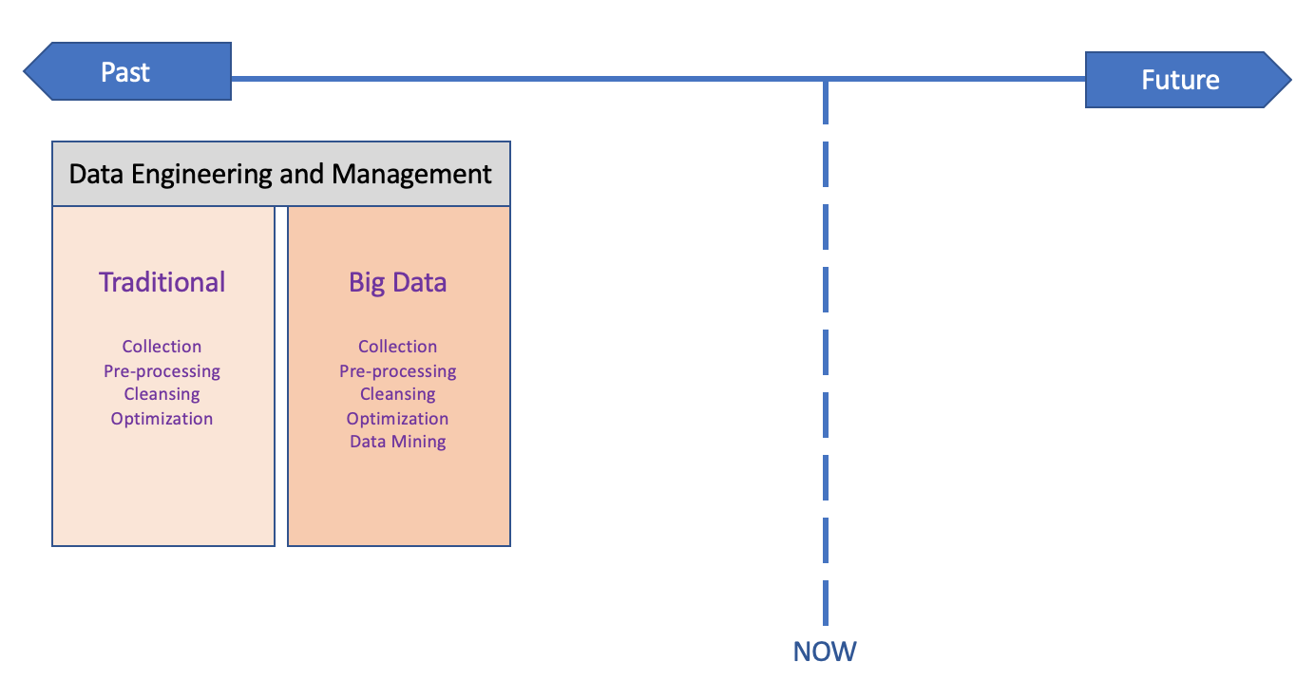
Data Visualization is the Pivot
Traditional metrics and reporting tools have been nearly entirely “rearward looking”.
  Able to answer questions of “what happened” quite well.
  Able to answer questions in the manner in which they were expected to be answered.

Slide 5
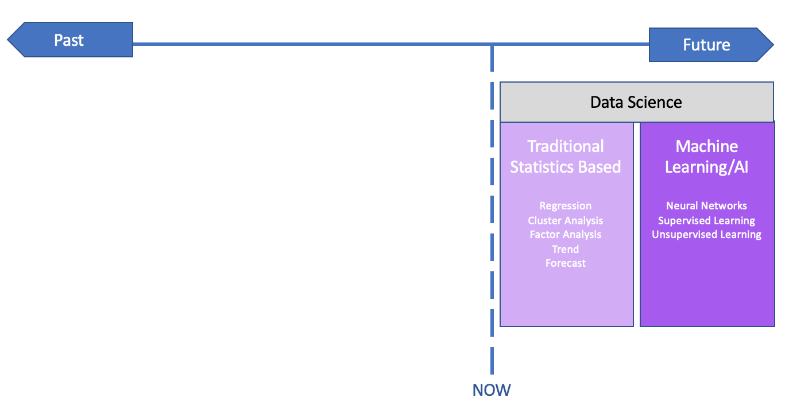
Data Visualization is the Pivot
Modern Data Science Techniques are “forward looking”.
  Able to answer questions of “what might happen” quite well.
  Able to answer questions in novel and unexpected ways.

Slide 6
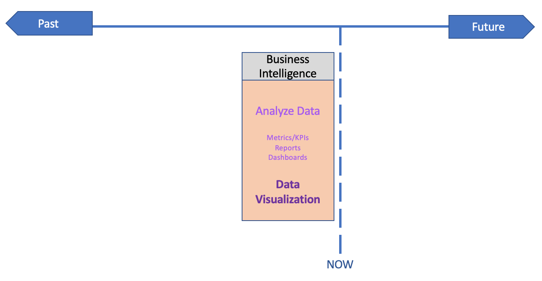
Data Visualization is the Pivot
Business Intelligence is the Pivot
  Business intelligence (BI) drives executive action.
  Illustrates what is working, what isn’t.
  Elicits new questions/directions.
  Performs this task visually.

Slide 7
Data Visualization is the Pivot
Because the large majority of the results of BI analysis is presented visually, Data Visualization is the pivot between:
  The Past (ANALYSIS)
  The Future (ANALYTICS)

Slide 8
Business Intelligence Lifecycle
Past
Future
Data Engineering and Management
Business Intelligence
Data Science
Traditional
Collection
Pre-processing
Cleansing
Optimization
Big Data
Collection
Pre-processing
Cleansing
Optimization
Data Mining
Analyze Data
Metrics/KPIs
Reports
Dashboards
Data Visualization
Traditional
Statistics Based
Regression
Cluster Analysis
Factor Analysis
Trend
Forecast
Machine Learning/AI
Neural Networks
Supervised Learning
Unsupervised Learning
NOW

